Slide 1
DEALING WITH COMPUTATIONAL INTRACTABILITY

Slide 2
The First-Order Case
Consider, for example, the KB consisting of a single formula (again in the domain of arithmetic):
∀x∀y. LessThan(succ(x), y) ⊃ LessThan(x, y)
Suppose our query is LessThan(zero,zero). Obviously, this should fail because the KB does not entail the query (nor its negation). The problem is that if we pose it to Resolution, we get derivations like the one shown in Figure. Although we never generate the empty clause, we might generate an infinite sequence looking for it. Among other things, this suggests that we cannot simply use a depth-first procedure to search for the empty clause, because we run the risk of getting stuck on such an infinite branch.

Slide 3
The First-Order Case…
We might ask if there is any way to detect when we are on such a branch, so that we can give it up and look elsewhere. The answer unfortunately is no. The FOL language is very powerful and can be used as a full programming language. Just as there is no way to detect when a program is looping, there is no way to detect if a branch will continue indefinitely. This is quite problematic from a knowledge representation point of view, because it means that there can be no procedure that, given a set of clauses, returns satisfiable when the clauses are satisfiable and unsatisfiable otherwise.12 However, we do know that Resolution is refutationcomplete: If the set of clauses is unsatisfiable, some branch will contain the empty clause (even if some branches may be infinite). So a breadthfirst search is guaranteed to report unsatisfiable when the clauses are unsatisfiable. When the clauses are satisfiable, the search may or may not terminate.

Slide 4
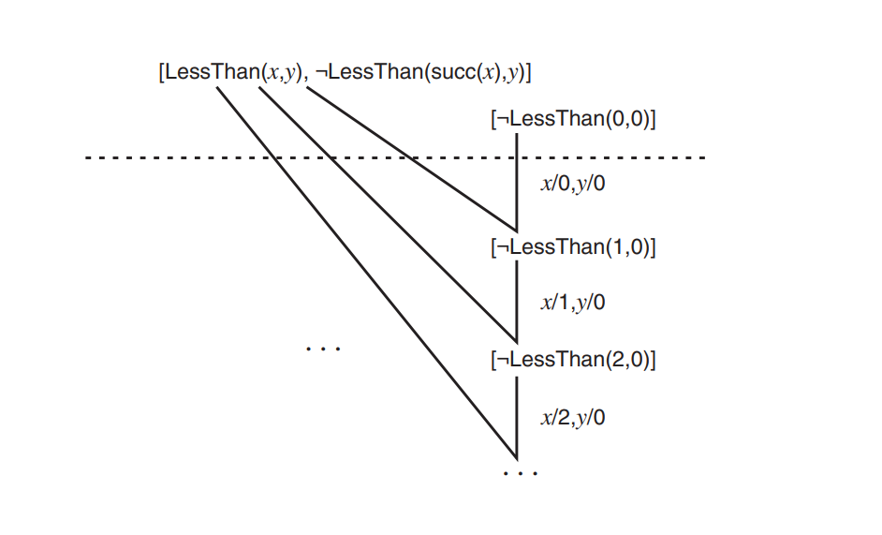
The First-Order Case…

Slide 5
The Herbrand Theorem
in the propositional case we can run Resolution to completion, so we never have the nontermination problem. An interesting fact about Resolution in FOL is that it sometimes reduces to this propositional case. Given a set S of clauses, the Herbrand universe of S (named after the logician who first introduced it) is the set of all ground terms formed using just the constants and function symbols in S. 13 For example, if S mentions just constants a and b and unary function symbol f , then the Herbrand universe is the set
{a, b, f(a), f(b), f(f(a)), f(f(b)), f(f(f(a))), ...}

Slide 6
The Herbrand Theorem…
The Herbrand base of S is the set of all ground clauses cθ where c ∈ S and θ assigns the variables in c to terms in the Herbrand universe. Herbrand’s Theorem states that a set of clauses is satisfiable if and only if its Herbrand base is. The reason this is significant is that the Herbrand base is a set of clauses without variables, so it is essentially propositional. To reason with the Herbrand base it is not necessary to use unifiers and so on, and we have a sound and complete reasoning procedure that is guaranteed to terminate. The catch in this approach (and there must be a catch, because no procedure can decide the satisfiability of arbitrary sets of clauses) is that

Slide 7
The Herbrand Theorem…
the Herbrand base will typically be an infinite set of propositional clauses. It will, however, be finite when the Herbrand universe is finite (no function symbols and only finitely many constants appear in S). Moreover, sometimes we can keep the universe finite by considering the “type” of the arguments and values of functions, and include a term like f(t) only if the type of t is appropriate for the function f . For example, if our function is birthday (taking a person as argument and producing a date), we may be able to avoid meaningless terms like birthday(birthday(john)) in the Herbrand universe

Slide 8
The Propositional Case
If we can get a finite set of propositional clauses, we know that the Resolution procedure in Figure above will terminate. But this does not make it practical. The procedure may terminate, but how long will it take? We might think that this depends on how good our procedure is at finding derivations. However, in 1985, Armin Haken proved that there are unsatisfiable propositional clauses c1, ... , cn such that the shortest derivation of the empty clause has on the order of 2n steps. This answers the question definitively: No matter how clever we are at finding derivations, and even if we avoid all needless searching, any Resolution procedure will still take exponential time on such clauses, because it takes that long to get to the end of the derivation.

Slide 9
The Propositional Case…
We might then wonder if this is just a problem with Resolution: Might there not be a better way to determine whether a set of propositional clauses is satisfiable? As it turns out, this question is one of the deepest ones in all of computer science and still has no definite answer. In 1972, Stephen Cook proved that the satisfiability problem was NP-complete: Roughly, any search problem where we are searching for an item satisfying a certain property, and where we can test in polynomial time whether a candidate item satisfies the property, can be recast as a propositional satisfiability problem. The importance of this result is that many problems of practical interest (in areas such as scheduling, routing, and packing) can be formulated as search problems of this form. Thus a polynomial time algorithm for satisfiability (which Haken proved Resolution is not) would imply a polynomial time algorithm for all of these tasks.

Slide 10
The Propositional Case…
Because so many people have been unable to find good algorithms for any of them, it is strongly believed that propositional satisfiability cannot be solved at all in polynomial time. Proofs, however, like Haken’s for Resolution, have been very hard to obtain.

Slide 11
The Implications
So what are the implications of these negative results? At the very least, they tell us that Resolution is not a panacea. For knowledge representation purposes, we would like to be able to produce entailments of a KB for immediate action, but determining the satisfiability of clauses may simply be too difficult computationally for this purpose.

Slide 12
The Implications…
We may need to consider some other options. One is to give more control over the reasoning process to the user. Another option is to consider the possibility of using representation languages that are less expressive than full FOL or even full propositional logic. Much of the research in knowledge representation and reasoning can be seen as attempts to deal with this issue.

Slide 13
The Implications…
On the other hand, it is worth observing that in some applications of Resolution it is reasonable to wait for answers, even for a very long time. Using Resolution to do mathematical theorem-proving, for example, to determine whether or not Goldbach’s Conjecture or its negation follows from the axioms of number theory, is quite different from using Resolution to determine whether or not an umbrella is needed when it looks like rain. In the former case, we might be willing to wait for months or even years for an answer. There is an area of AI called automated theorem-proving whose subject matter is precisely the development of procedures for such mathematical applications. The best we can hope for in such applications of Resolution is not a guarantee of efficiency or even of termination, but a way to search for derivations that eliminates unnecessary steps as much as possible. In the rest of this section, we will consider strategies that can be used to improve the search in this sense.

